Slide 1

Field of Dentistry
Lecture : (Autonomic Nervous System 1 )
Dr : (Mohamed Talal)
Date : /9 /2026

Slide 2

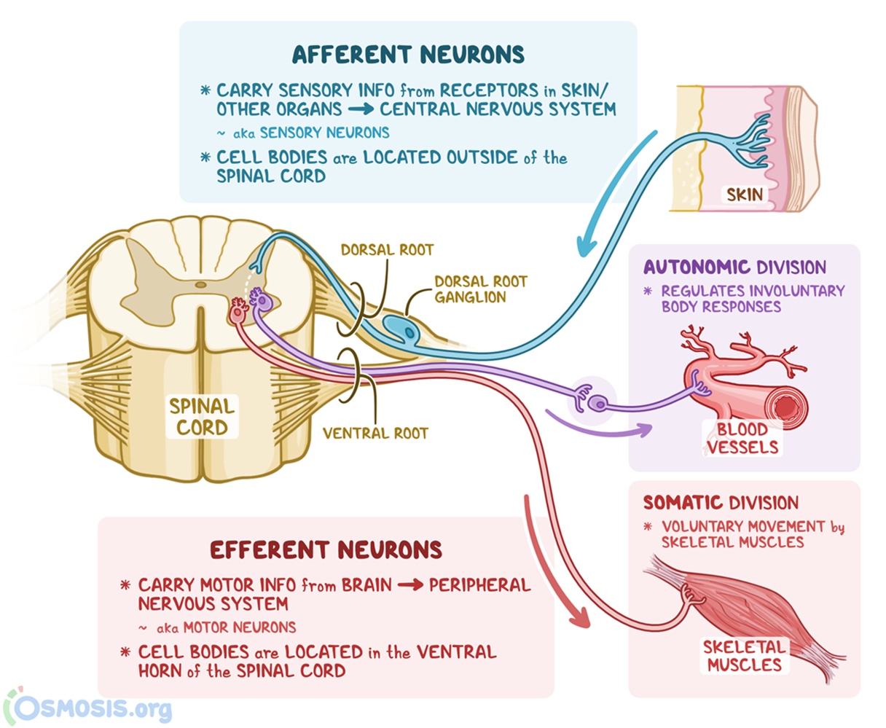
Autonomic nervous system
Structure and origin :

Slide 3
Autonomic nervous system
Functional division of the nervous system:
 | Sensory nervous system | Motor nervous system | Autonomic nervous system
Function | Carry neural impulses from skin to CNS. | Carry neural impulses from the CNS to the skeletal muscles. | Carry neural impulses from CNS to smooth and cardiac muscles
Location of cell body | Outside the spinal cord | Inside the spinal cord | Inside the spinal cord
Site in grey matter | Dorsal horn | Ventral horn | Lateral horn

Slide 4
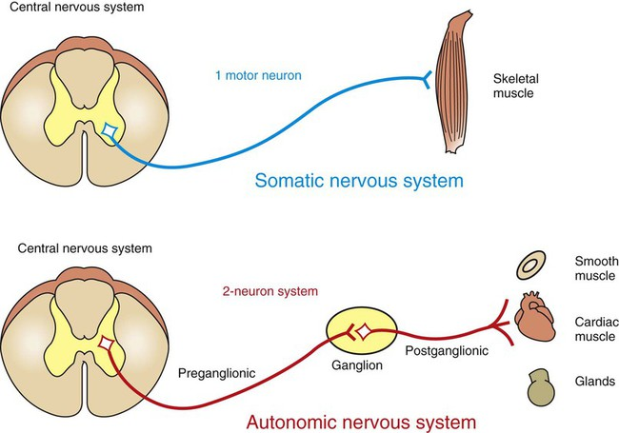
Autonomic nervous system

Slide 5
Autonomic nervous system
 | Autonomic nervous system | Somatic nervous system
Control | Involuntary | Voluntary
Type | 2 types | One
Efferent | 2 efferent | One
Muscle | Smooth muscle – cardiac muscle | Skeletal muscle
Chemical transmitter | Acetylcholine Norepinephrine | Acetylcholine
Autonomic ganglia | Present | Absent
Arise from | LHC | AHC

Slide 6
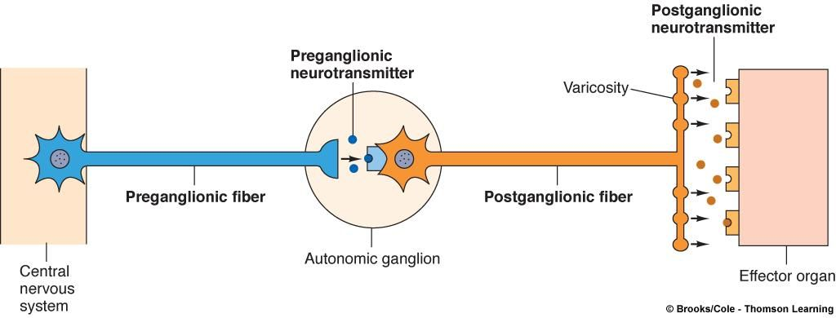
Autonomic nervous system
Autonomic ganglia :

Slide 7
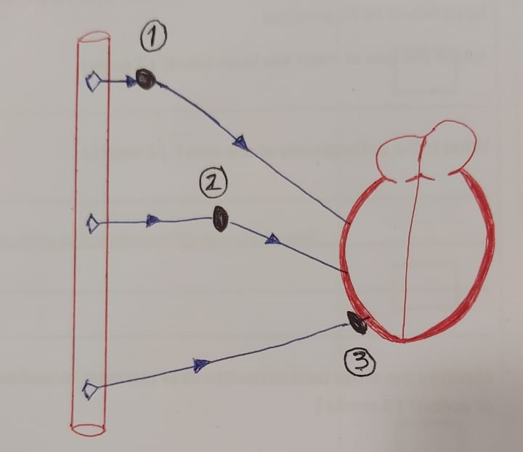
Autonomic nervous system
Autonomic ganglia :
Definition: collection of neurons outside CNS
Function: acts as distributing center
Types:
  paravertebral ganglia ( lateral )
  collateral ganglia
  terminal ganglia

Slide 8
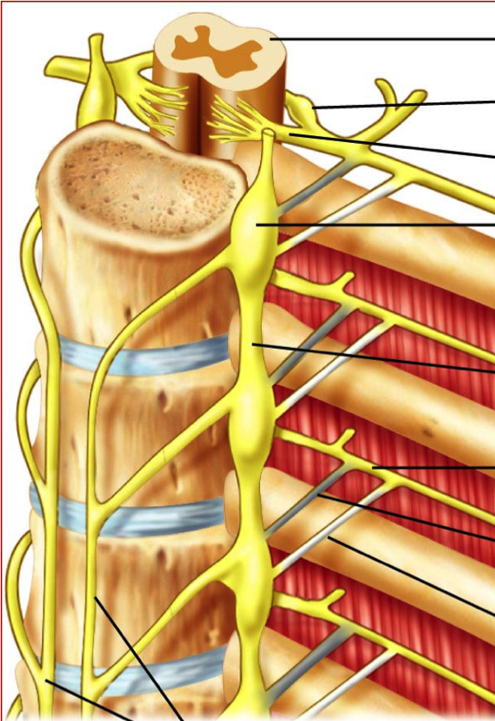
Autonomic nervous system
paravertebral ganglia ( lateral )
    present on both sides of vertebral column
    relay of sympathetic nervous system

Slide 9
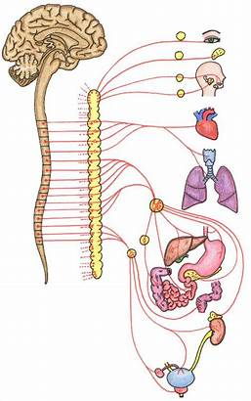
Autonomic nervous system
collateral ganglia :
    present midway between spinal cord and viscera.
    relay of sympathetic .
    relay of parasympathetic .
terminal ganglia :
    present near or inside the viscous.
    relay of parasympathetic.

Slide 10
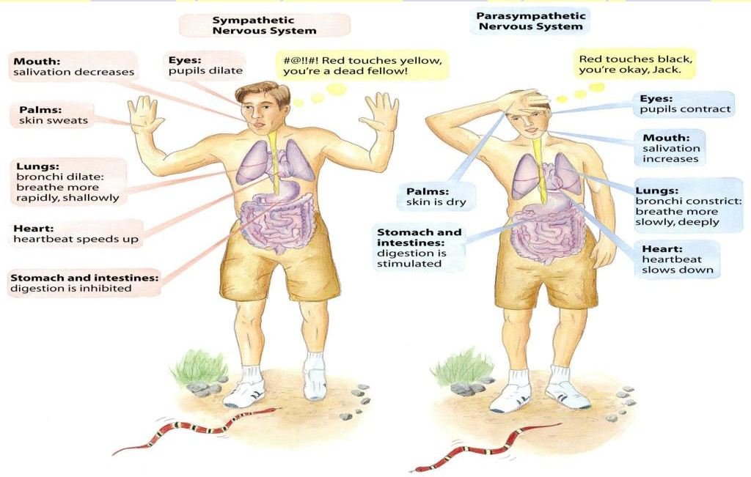
Divisions of Autonomic nervous system
Sympathetic nervous system.
Parasympathetic nervous system.

Slide 11
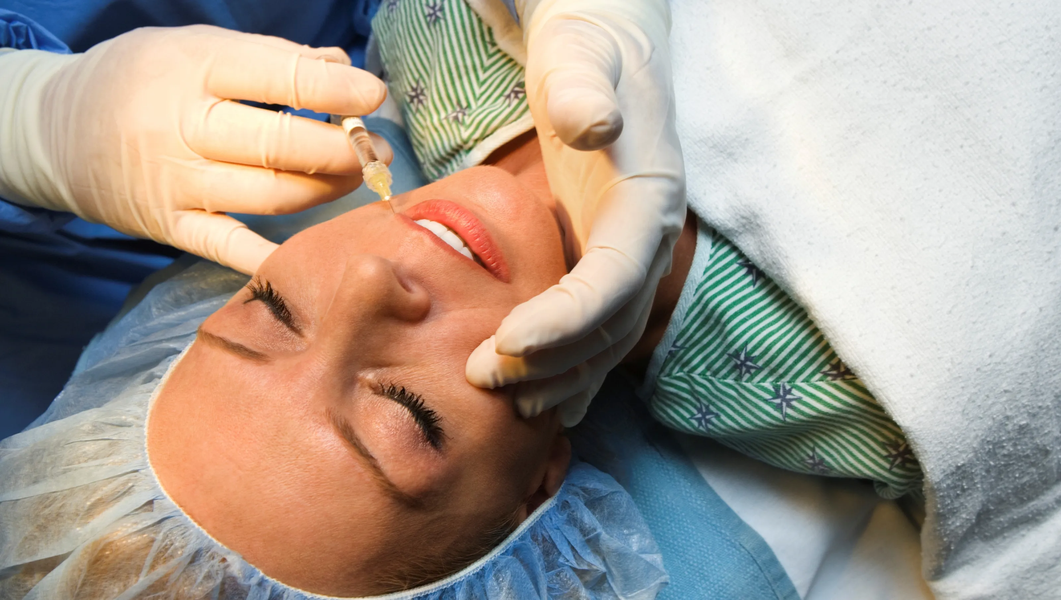
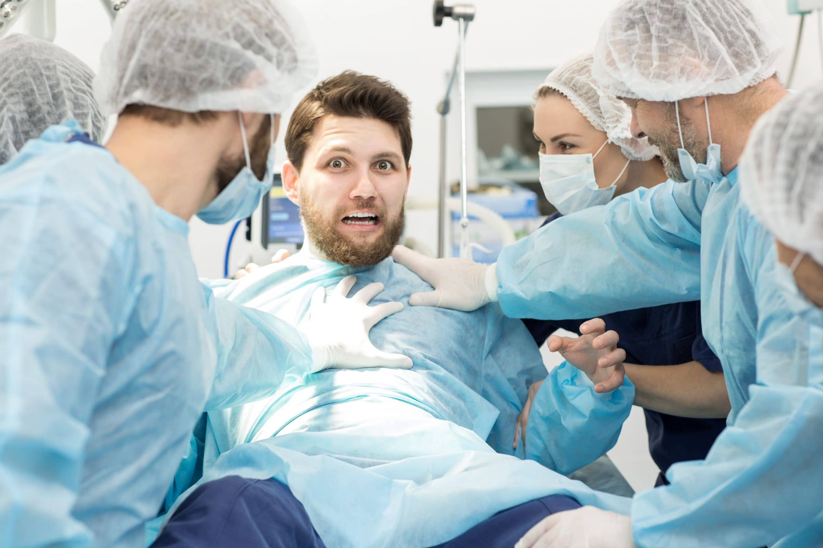

Divisions of Autonomic nervous system
Sympathetic nervous system.

Slide 12
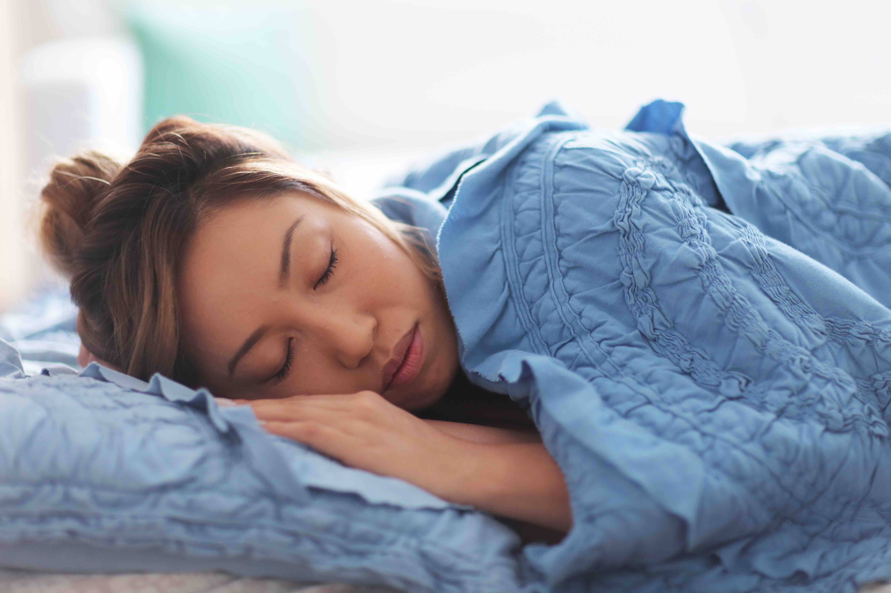
Divisions of Autonomic nervous system
2. Parasympathetic nervous system.

Slide 13
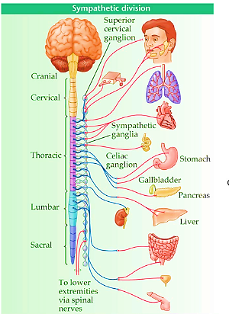
sympathetic nervous system
Origin :
thoracolumbar (LHC of all thoracic and upper 3 lumbar segments)

Slide 14
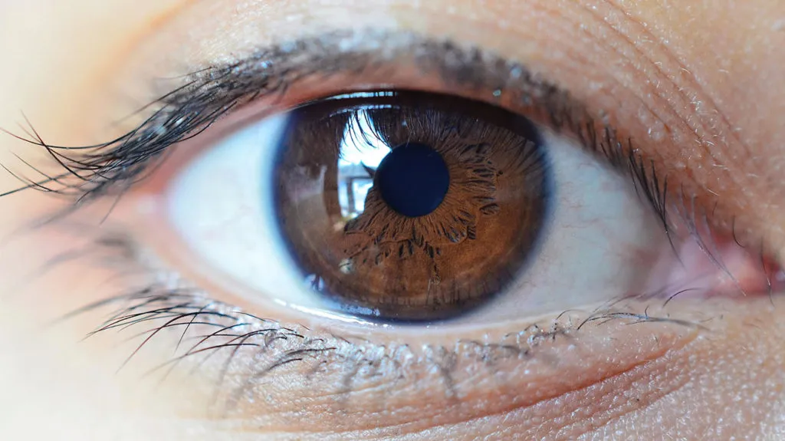
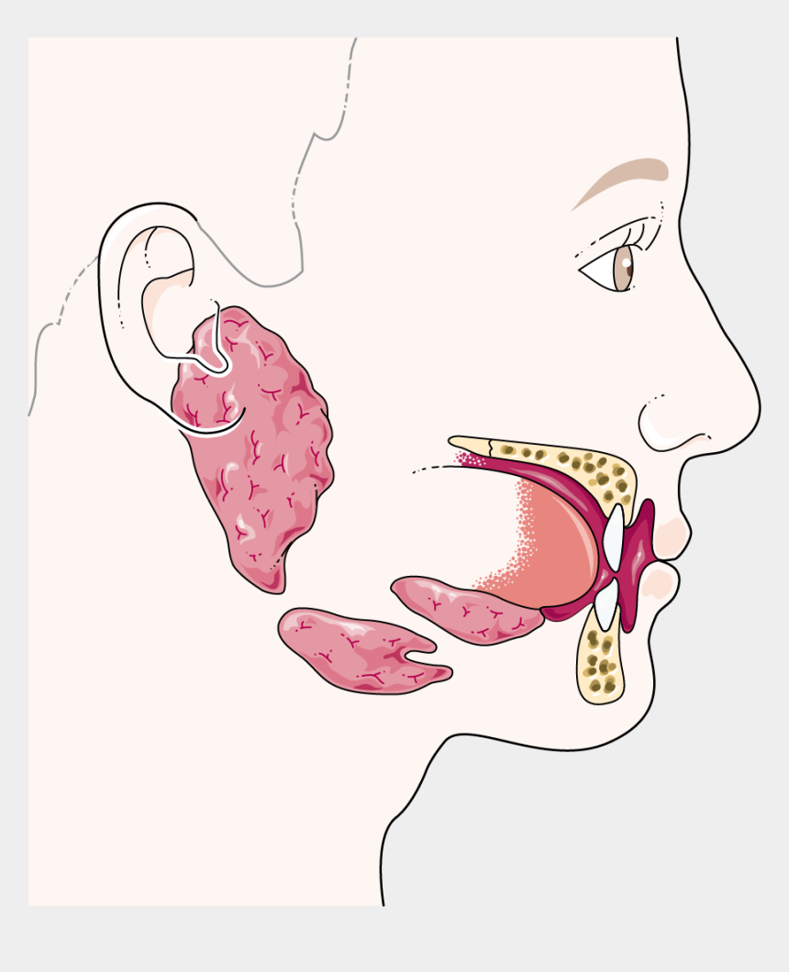
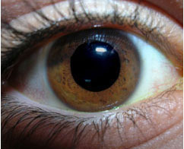
functions of sympathetic nervous system
On head and neck :
Eye:
  pupil dilatation ( mydriasis ) due to contraction of dilator pupillae muscle
  elevation of upper eyelid ( widening of palpebral fissure )
  decrease tear secretion of lacrimal gland
Salivary glands:
  Decreases salivary secretions

Slide 15
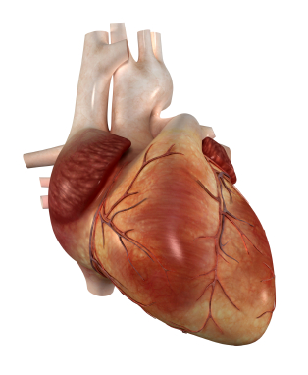
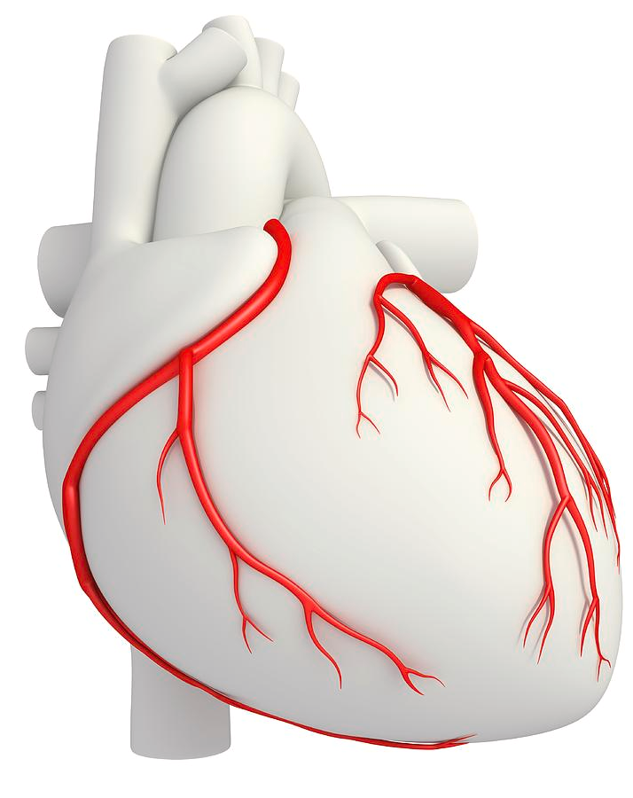
functions of sympathetic nervous system
On thorax : ( heart and lung )
Heart:
  increase excitability and rate of conduction.
  +ve inotropic effect ( increase in force of contraction )
  +ve chronotropic effect ( increase in heart rate )
  vasodilatation of coronary vessels.

Slide 16
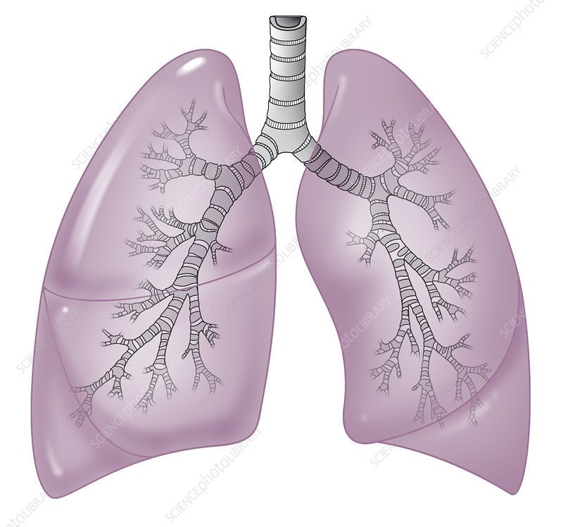
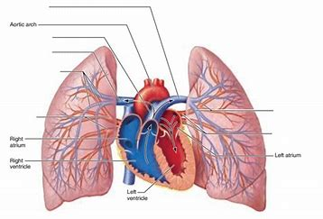
functions of sympathetic nervous system
On thorax : ( heart and lung )
Lung:
    bronchodilatation ( relaxation of bronchial muscles ).
    vasoconstriction of pulmonary vessels.

Slide 17
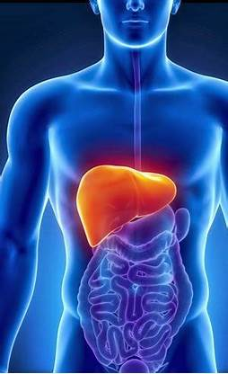
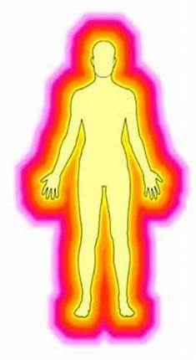
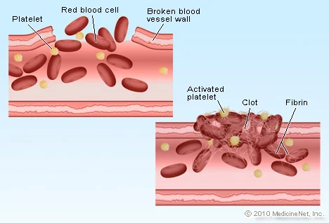
functions of sympathetic nervous system
on abdomen :
Liver:
  glycogenolysis ( hyperglycemia ).
  increase metabolic rate.
  increase fibrinogen synthesis ( limit bleeding ).

Slide 18
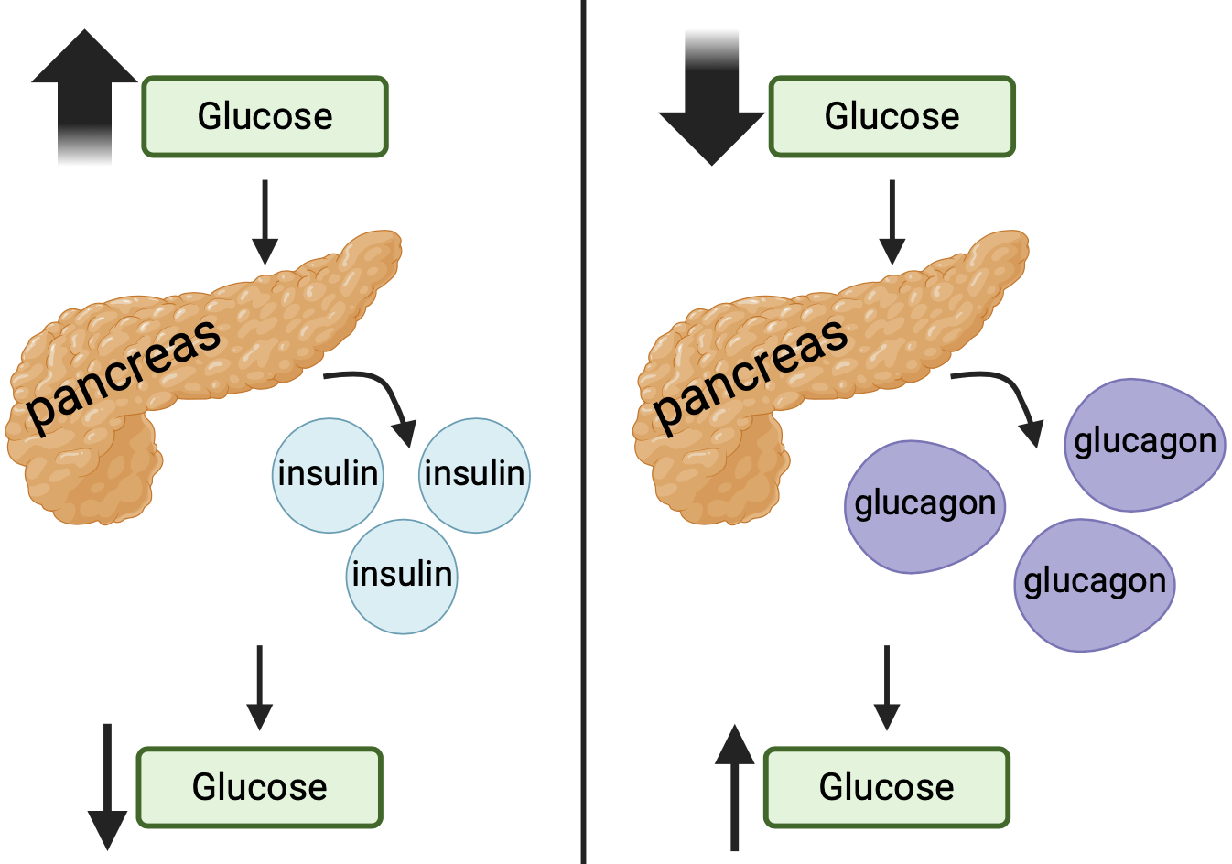
functions of sympathetic nervous system
on abdomen :
Pancreas:
  Stimulates glucagon secretion.
  inhibits insulin secretion.

Slide 19
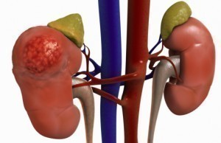
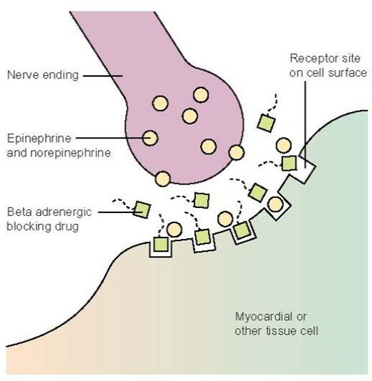
functions of sympathetic nervous system
on abdomen :
Adrenal medulla:
  secretion of 80% adrenaline – 20% noradrenaline.
Adrenaline | Noradrenaline
Greater effect on : Cardiac contractility ( β₁) | Greater effect on arterial blood pressure ( VC via α1 )

Slide 20
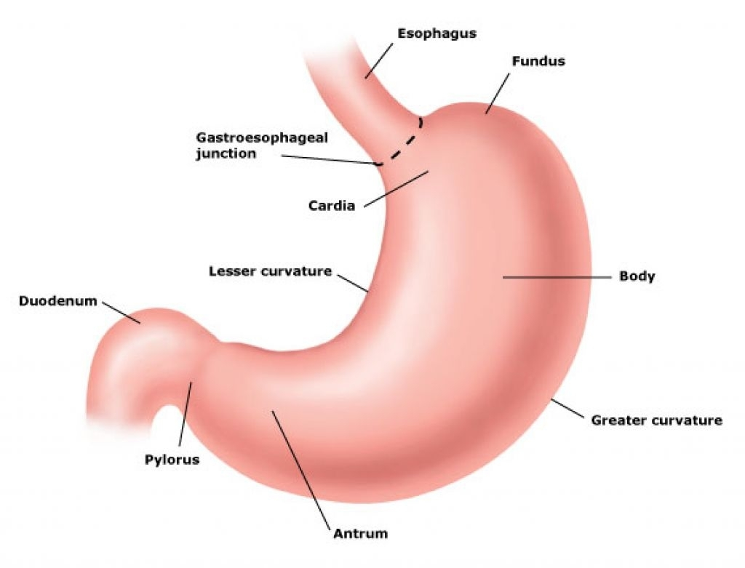
functions of sympathetic nervous system
on abdomen :
Gastrointestinal tract:
  Inhibition ( relaxation ) of wall.
  contraction of sphincters.

Slide 21
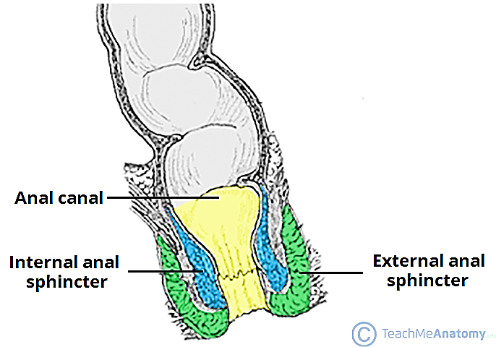
functions of sympathetic nervous system
On pelvis :
Rectum: (retention of feces)
  inhibition of wall.
  contraction of internal anal sphincter.

Slide 22
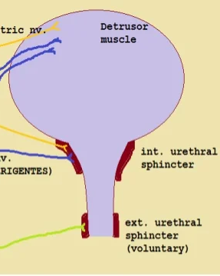
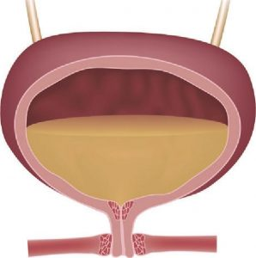
functions of sympathetic nervous system
On pelvis :
Urinary bladder: (retention of urine)
  inhibition of wall.
  contraction of internal urethral sphincter.

Slide 23
functions of sympathetic nervous system
On pelvis :
Male genitalia:
  Ejaculation.

Slide 24


